Slide 1
The Neighbourhood Health Model
Acknowledging the work over at least 5 years from partners across the Joined-Up Care Derbyshire (JUCD) system
Notes:
Need for space at the Parntership level where people can come together, talk and influence
Workshop on the design stuff – bottom up
DCC meeting – coming in to contract one organisation to do the connecting is concerning
System conditions that drive us and allow us to do the right thing locally
Social determinants and disillusion in the disempowerment
Language – need to get it right…..neighbourhood
Still hearing top down and bottom up in my language and challenge on using horizontal language more
Need some lessons to statutory organisations on mecahnisms for contracting/funding/measuring VCSE….and ways of working that reduce additional costs
Chris P point on creating communities of practice being important
Speaking out has resulted in detriment – hope this turning of the tanker will happen

Slide 2
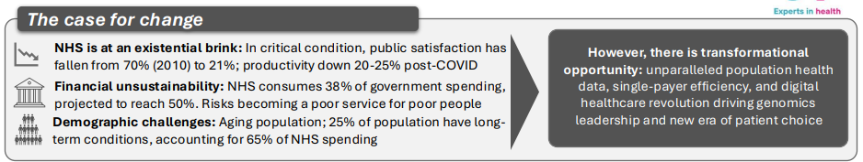
The NHS 10 Year Plan: Shifts
Shift 1: Hospital to Community
Neighbourhood Health Service to bring care into the places people live. Infrastructure: neighbourhood health centres open 12hr/day, 6 days/week. 1 stop shop for patients care, collocating NHS, council and voluntary services Patient empowerment: 95% complex patients to have care plans by 2027; 1m personal health budgets by 2030 Financial Reallocation: 15% lower NEL, 10% lower ambulance observed in systems spending more on community services. £100 spent on community care can unlock £131 of acute savings (CF/NHS Confed) Digital Transformation: 2/3 OPAs to be replaced with digital advice
Shift 2: Analogue to Digital
NHS App as “front door”: AI powered advice, appointment booking, self management, care plans + HealthStore for approved digital health apps Single Patient Record: patients control their data, accessible by NHS App by 2028. Supplemented by advances in genomic data for personalised predictive care Staff Liberation: ambient voice technology reduces paperwork by 51%. New tools being tested on Federated Data Platform, which connects info across healthcare settings and links siloed sources, increasing productivity.
Shift 3: Treatment to Prevention
Tobacco: create a smoke free generation Alcohol: mandatory health warning labels for alcohol; increasing alcohol free threshold to0.5% ABV Obesity: Expand health start scheme free school meals (Sept 26). Increase soft drinks levy. Collaborations with Industry. Digital NHS points scheme rewarding people taking healthy actions Mental Health: mental health support teams in schools and colleges 2029/30 Geonomics Population Health Service: predictive and personalised medicine. Vaccinations and Screenings for Disease Elimination: via Neighbourhood Health Service.
Reference Carnall Farrar (250701_10YP_snapshot-1.pdf)

Slide 3
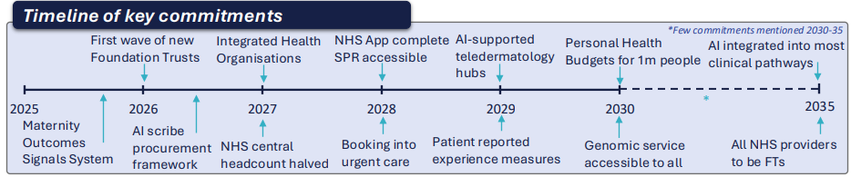
The NHS 10 Year Plan: Enablers
Enabler 1: New Operating Model
Merge NHSE with DHSC (headcount halved by 2027) Earned Autonomy: every NHS provider a Foundation Trust by 2035. Some to be Integrated Health Organisation from 2027 holding population health budgets ICBs to be Strategic Commissioners: Aim to be coterminous with strategic authorities
Enabler 2: New Transparency of Care
League Tables of Provider and Patient-Reported Experience Measures to be published Revitalise the National Quality Board: a single authority on quality, supported by Dr Penny Dash’s report. AI Led Warning System: building on Federating Data Platform to identify services at high risk, based on clinical data
Enabler 3: Workforce Transformation
Fewer but Better Equipped Staff (AI training for all) Advanced Practice Roles: for nurses/AHPs; reduce international recruitment to <10% by 2035 Ultra Flexible Employment Contracts: Eliminate agency staffing by parliament end; prioritise staff wellbeing to save cost of poor wellbeing among NHS staff
Enabler 4: Innovation and Technology
Five “Big Bets”: Data, AI, Genomics & Predictive Analysis, Wearables, Robotics Global Institutes for Each Bet: NIHR funded. Regional Health Innovation Zones to bring together ICBs, Providers and Industry. Clinical Trial Set Up: faster and volunteering via NHS App Pro-Innovation Regulation: MHRA/NICE joint process £600m Health Data Research Service
Enabler 5: Finance & Productivity
2% annual productivity gains (pre-pandemic levels by parliament end) Deficit Funding Phased Out by 2026/27 Multi-Year Budgets: with 3%+ of budget for service transformation Patient Power Payments: patient satisfaction to influence provider payments New Capital Models: incl. private finance and pension fund partnerships
Reference Carnall Farrar (250701_10YP_snapshot-1.pdf)

Slide 4

But…
This Isn’t New!
It started in 2012 with the Health and Care Act and has featured in national narrative ever since and in our JUCD priorities and successes
“You might not need to change current structures. In Leeds, we… didn’t change people’s organisations, but we worked in a more integrated way [across community services, GPs, and adult social care],” she said. “Every time we have a structural reorganisation, it costs millions of pounds”.
https://www.hsj.co.uk/policy-and-regulation/government-warned-against-10-year-plan-restructure/7039493.article
We’ve Achieved A Lot!
Team Up
GP Model
Empowering General Practice
End of Life Care
Living Well
Function
Before Form!
We have importantly developed our functions first
Now we need some form!
Notes:
A Clear National Direction Towards Integration
Over the last decade, national guidance has consistently pointed toward more integrated, community-based health and care services. Here’s a quick overview:
2012: Health and Care Act Introduced a Duty to Promote Integration — encouraging health, social care, and related services to work together when it would improve quality or reduce health inequalities. However, this was initially complicated by competition rules in the same Act. It also enabled collaboration through tools like Section 75 and Section 65Z5 agreements, allowing budgets to be pooled and responsibilities to be shared or delegated between organisations.
2019: NHS Long Term Plan Committed to increasing integrated and community-based care. This included expanding community multidisciplinary teams (MDTs) aligned with Primary Care Networks (PCNs) to offer more personalised, coordinated, and proactive care.
2019: PCN Directed Enhanced Service (DES) Launched integrated MDTs to support local neighbourhood populations of 30,000–50,000. These teams aim to:
Integrate care between GPs and community services
Deliver holistic, person-centred care
Use population health management (PHM) to deliver more proactive support
Reduce pressure on hospitals and urgent care
Work with voluntary and community partners to tackle wider determinants of health
2022: Claire Fuller’s Stocktake Highlighted the need to better integrate primary care at neighbourhood level to improve health outcomes and tackle inequalities.
2023: Patricia Hewitt’s Review Focused on the role of Integrated Care Systems (ICSs) in delivering neighbourhood-level services, emphasising local partnerships and community involvement.
2024: Lord Darzi’s Review & 2025/26 Planning Guidance Backed the move towards neighbourhood-based MDTs to address system pressures. It outlined three key shifts:
From acute care to community care
From treatment to prevention
From analogue to digital systems
2025: Provider Selection Regime Introduced under the Health and Care Act 2022 to overcome integration challenges created by previous competition-focused procurement rules.
National Changes
We are currently undergoing significant reorganisation across both health and care, with significant cost savings being driven across the whole of the NHS and a national restructuring of local authority footprints and make up. This is complimented by an aging population with increasingly complex needs, and a national agenda for Children and Young People and Mental Health that is focussed on integrated working.
Approaches to Integration: What We’re Doing Differently in Derby and Derbyshire
Across the country, many ICSs and ICBs have focused on creating formal structures for delivery — often mirroring the tiers suggested in the Fuller review. While some areas have strong models, the real-world impact is often limited.
In Derby and Derbyshire, we’ve taken a different approach. Instead of focusing on structure, we’ve prioritised functions and outcomes — and it’s working. We’re proud of the progress made through several key initiatives:
GP Provider Board & the GP Model Developed to support the Empowering General Practice Programme (EGPP) using a Population Health Management approach. PCNs are testing new ways to manage complex care needs, improving continuity and reducing demand on hospital and urgent care services.
Integrated Place-Based Enablement (IPE) Driving prevention-focused initiatives like Team Up, end-of-life care (EoLC), and hospital discharge improvements.
Examples of What’s Working:
Team Up Local MDTs supporting specific neighbourhood populations, both reactively and proactively, to help people stay well at home. It’s already led to fewer emergency department visits due to falls and a drop in A&E attendances among people over 65 with severe frailty. NB This is an all-age approach, but impact has focussed on the >65 as they form the majority of the population we have worked with.
Maternity Integration: in Chesterfield they have piloted embedding their midwives into the community and neighbourhoods. This has positively impacted on maternal care through increased continuity and improved patient engagement, and it has helped to create community connection and support for mums and their newborns by seeing them in local support settings.
Barrow Hill A regeneration project showing how the ICS is addressing health inequalities through neighbourhood-level investment and partnership. It focuses on community-led solutions and healthier lifestyles.
Empowering General Practice Programme Enables PCNs to work in new, flexible ways tailored to patient complexity and local need. This supports better use of clinical time and improves care continuity. E.g. South Hardwick - optimising pharmacy relationships, and maximising the support available to patients; South Dales – falls prevention in the home.
Local Area Coordination Teams in Derby City – in fact there is a lot of learning for us to take from Local Authority Neighbourhood working that we can draw from
Gynae Pathways between primary care and UHDB sub-contracting arrangements in place to improve care

Slide 5
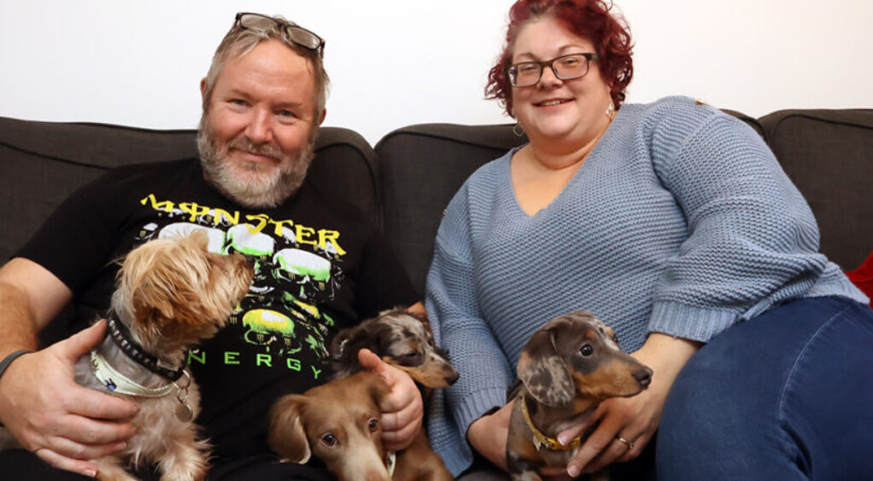
A Bit More on Team Up in Derby and Derbyshire: Robert’s Story
https://youtu.be/xVIedZKih84

Slide 6
Problem Statements
1
A Disempowered Population; increasingly dependent on health and social care support
2
Difficulty in Enabling Local Innovation While Maintaining System-Wide Insight
3
Lack of Scalable Accountability Frameworks Across System Levels
4
Lack of Infrastructure for Managing Pooled Budgets in Integrated Care Delivery
Notes:
Based on all of the national thinking and context, as well as our local initiatives and learning, we started by thinking about the problems we needed to solve based on where we are in Derby and Derbyshire to really scale up integrated working in Neighbourhoods and achieve the three shifts set out nationally: Acute to Community; Treatment to Prevention and Analogue to Digital.
From our national contacts we are also aware that Paul Corrigan is talking a lot about how we can build an autonomous population and how we are building their agency
1. A Disempowered Population; increasingly dependent on health and social care support
As health and care dependency increases, many individuals – especially those facing long-term conditions or disadvantage – experience a loss of agency and control over their lives. To create a more equitable and person-centred system, we must shift from a model of passive care to one that actively supports people to lead, choose and shape their own paths
2. Difficulty in Enabling Local Innovation While Maintaining System-Wide Insight
There is a systemic tension between empowering local actors to innovate and deliver care based on community needs, and the need to aggregate, interpret and report on these activities at a system-wide level. The absence of mechanisms to bridge this gap impairs the ability to lean from local practice, scale what works, and demonstrate overall system impact
3. Lack of Scalable Accountability Frameworks Across System Levels:
Current accountability structures are not designed to operate effectively across different layers of the health and care system – local, neighbourhood and place. This results in fragmented oversight, misaligned incentives and challenges in ensuring coherence between policy objectives and delivery outcomes at all levels
4. Lack of Infrastructure for Managing Pooled Budgets in Integrated Care Delivery:
There is a lack of robust financial infrastructure and governance mechanisms to hold, allocate and manage large pooled budgets across multiple organisation involved in integrated care delivery. This limits the ability to optimise the efficiencies that cross-sector initiatives present arrangements.

Slide 7
Desired Outcomes
1
Empowered Local Decision-Making Through Scaled Collaboration
2
A Culture of Trust and Accountability Across the System
3
Improved Health Outcomes with Locally Tailored Delivery
4
People and Providers Who Are Supported, Resilient, and Connected
Notes:
Based on all of the national thinking and context, as well as our local initiatives and learning, we started by thinking about the problems we needed to solve based on where we are in Derby and Derbyshire to really scale up integrated working in Neighbourhoods and achieve the three shifts set out nationally: Acute to Community; Treatment to Prevention and Analogue to Digital.
From our national contacts we are also aware that Paul Corrigan is talking a lot about how we can build an autonomous population and how we are building their agency
1. A Disempowered Population; increasingly dependent on health and social care support
As health and care dependency increases, many individuals – especially those facing long-term conditions or disadvantage – experience a loss of agency and control over their lives. To create a more equitable and person-centred system, we must shift from a model of passive care to one that actively supports people to lead, choose and shape their own paths
2. Difficulty in Enabling Local Innovation While Maintaining System-Wide Insight
There is a systemic tension between empowering local actors to innovate and deliver care based on community needs, and the need to aggregate, interpret and report on these activities at a system-wide level. The absence of mechanisms to bridge this gap impairs the ability to lean from local practice, scale what works, and demonstrate overall system impact
3. Lack of Scalable Accountability Frameworks Across System Levels:
Current accountability structures are not designed to operate effectively across different layers of the health and care system – local, neighbourhood and place. This results in fragmented oversight, misaligned incentives and challenges in ensuring coherence between policy objectives and delivery outcomes at all levels
4. Lack of Infrastructure for Managing Pooled Budgets in Integrated Care Delivery:
There is a lack of robust financial infrastructure and governance mechanisms to hold, allocate and manage large pooled budgets across multiple organisation involved in integrated care delivery. This limits the ability to optimise the efficiencies that cross-sector initiatives present arrangements.

Slide 8
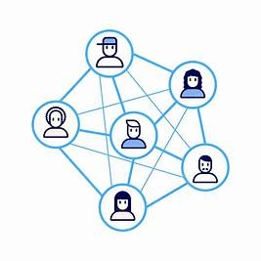
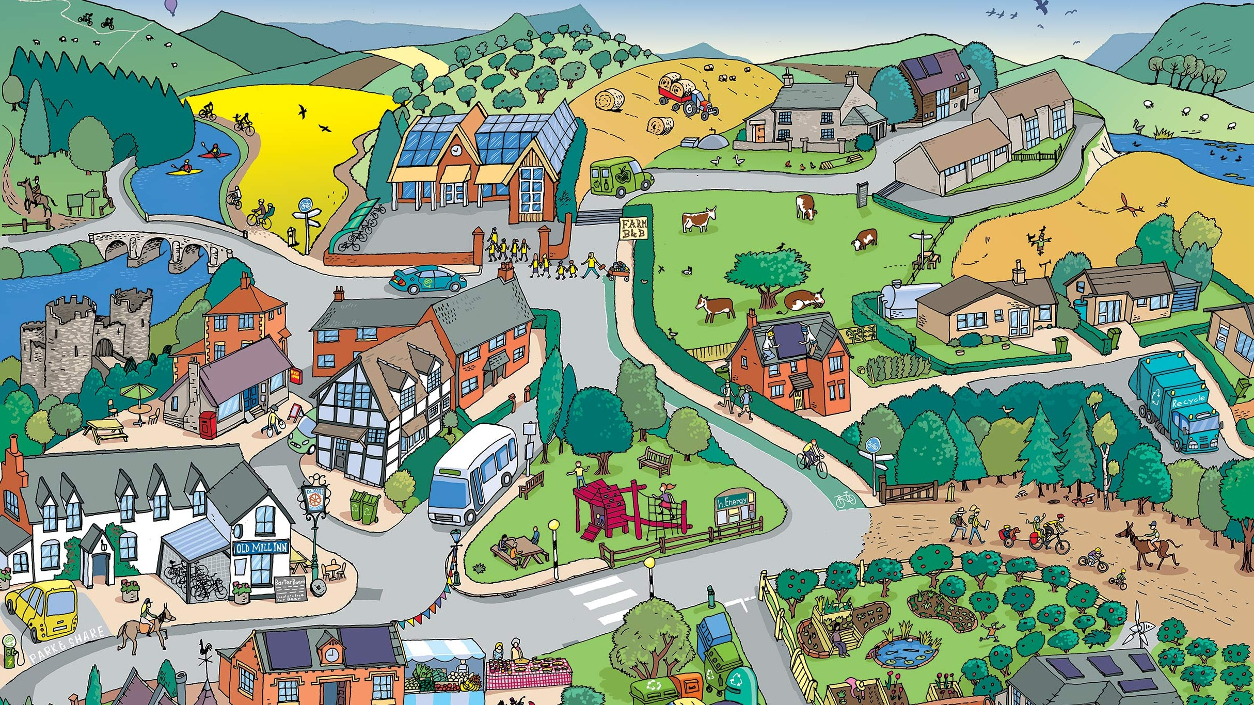

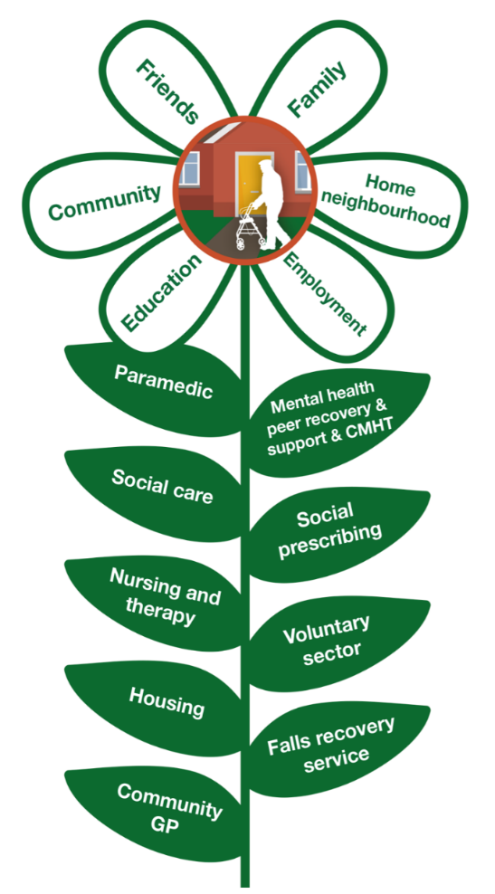
The Foundations of Our Neighbourhood Model
Culture & Relationships
Distributed Leadership
Strengths Based
Teaming Up

Slide 9


Using Features of Effective System Leadership
Hierarchical
Horizontal
Professionally Driven
Person-Centred
Prescriptive
Adaptive
Power-Centred
Seeks to Influence
Transactional
Relationship Based, Asset Focused
Territorial
Altruistic
Avoids Conflict
Solution Focused – surfaces conflict
Short-Term
Long-Term

Slide 10
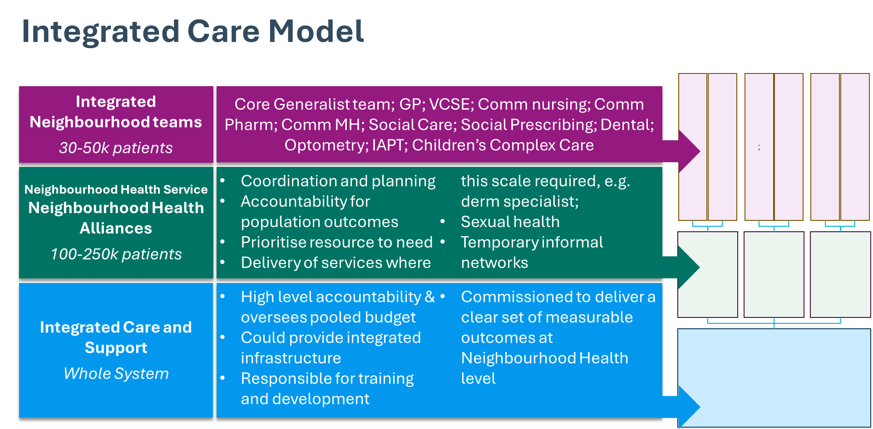
Working Framework: Principles
Integrated Care Model
We will recognise existing structures that work
We will bring together the strong foundations of Local Place Alliances and PCNs
We will recognise natural communities
We will recognise the current Local Authority boundaries, that are understood by our people and populations

Slide 11
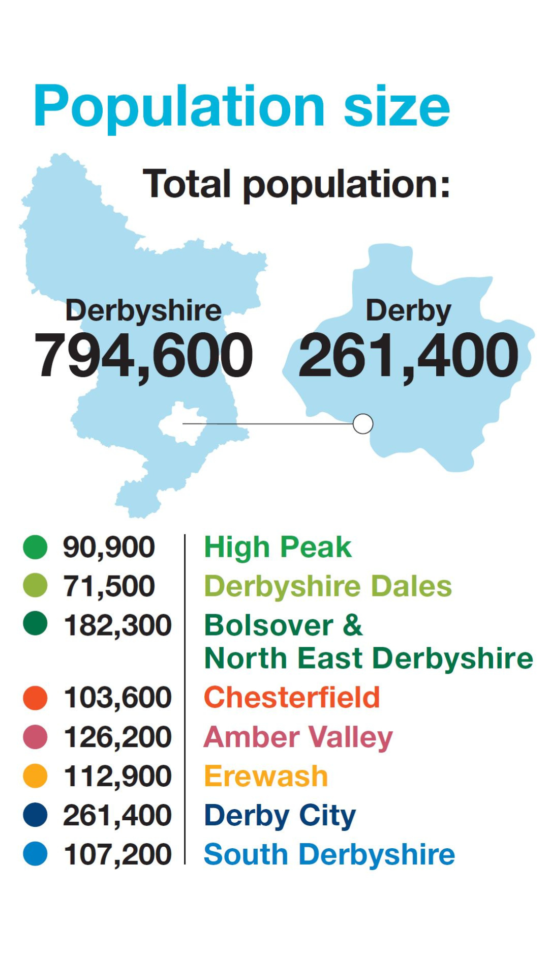
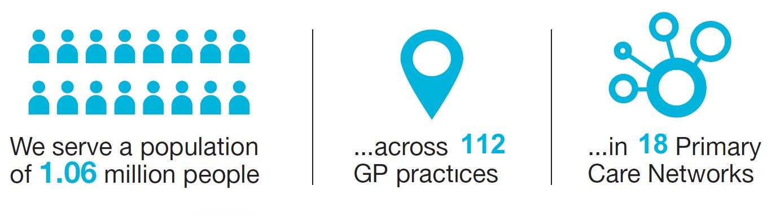
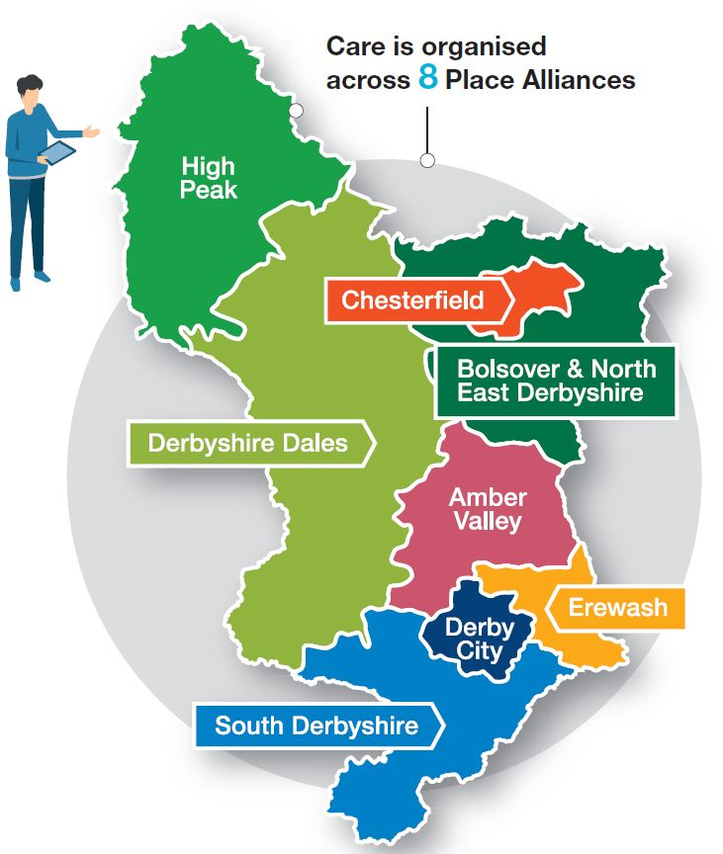
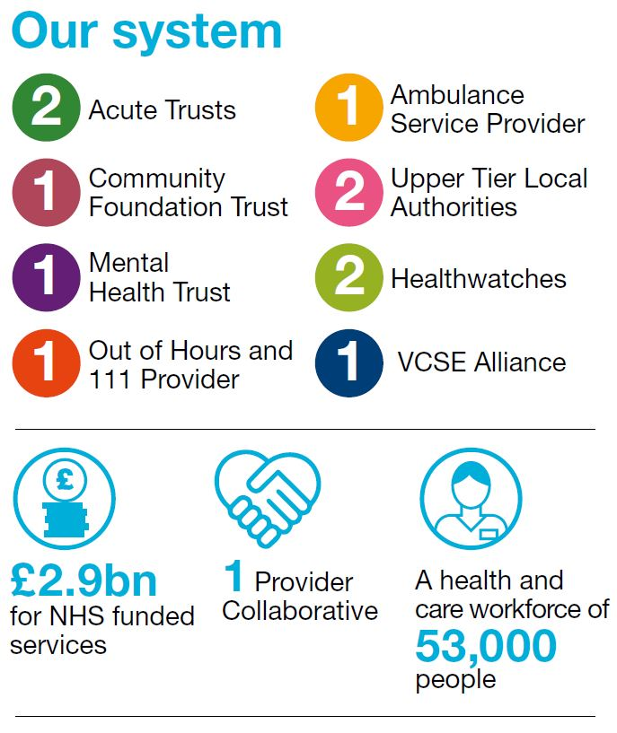
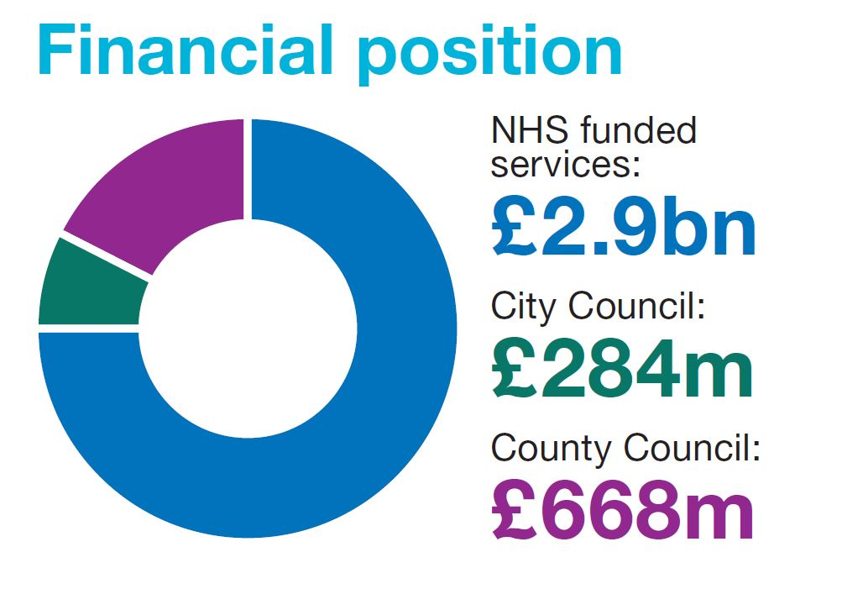
/Integrated Neighbourhood Teams
Neighbourhoods

Slide 12



Simply Put, What Will Be Different?
What’s Changing?
Care is being joined up in local neighbourhoods
Care will be closer to home
Services will work with people around what matters to them
What It Means for You
Integrated Working
Stronger Representation
Longer Term Contracts
Neighbourhood Outcomes
A Community Voice
How Can You Get Involved?
Share your views and experiences with us
Connect with your Neighbourhood Alliances
Advocate for your communities
Share what you learn with your communities

Slide 13

Our Accelerator Application
Summary: for Derby and Derbyshire Place
FOCUS: bringing together Physical and Mental Health Hubs in our Neighbourhoods, supported by some clear key enablers Prevention and Inequalities are a golden thread We identify as one Place, which means one application The leadership capacity required is confirmed and already operational We meet all the requirements provided to us by the National team This includes strong evidence of established integrated working (some of which was included in the 10 Year Plan itself)
Feedback
Two Options: 1) Single Application 2) Two Applications (Derby City and Derby County) Option 1 too big for the national programme Our commissioned expertise (GGI/Newton) tells us we are doing the right things We can still access: the national programme support We will be applying to the Newton Neighbourhood Community of Practice

Slide 14

Next Steps
Sept - Nov | Commissioning Intentions
 | We will develop a clear set of commissioning intentions alongside our Neighbourhood Model that further develop our integrated neighbourhood teams, improving access and experience for Derby and Derbyshire
Sept | Governance Framework and Maturity Matrix
 | The GGI has worked with our Neighbourhood Alliances and Integrated Teams to develop a Governance Framework and Maturity Matrix, which we will finalise and embed within our delivery governance
Oct | Launch of Our Neighbourhood Development Series
 | Following our leadership summit in May 25 we will create a development series that bring together health, care and VCFSE partners together to design, develop and implement neighbourhood ways of working
Oct - Nov | Defining our Integrated Health and Care Organisation
 | In line with the Blueprint, and supported by our Governance Framework and Maturity Matrix we will agree a set of clear principles and expectations of the I.H.O. that will promote and guide our providers to create the system infrastructure required for success
Oct Onwards | Integrated Neighbourhood Model Delivery Team
 | We will formalise the integrated leadership and oversight for the implementation of our model

Slide 15

Questions?
Notes:
DDICB – not starting from zero. Strength of culture and relationships must not be lost and most avoid reverting to transactional relationships
“Culture is King”. Since 10Y plan released the ref to neighbourhood and IHO constructs and absence of detail has led to a lot of posturing and land/power grabs, which is not what is about
Comfort in fact recognise lots of good stuff happening. Concern had been we might lose that and assured we won’t
Cross border working eg Erewash Notts/Derby really tricky: benefit of Cluster working AND benefit of strengthened contracting mechanisms. Will need to figure out with Cluster about what can be done commissioning/contracting for cross border operating. Relationships and understanding will be key
Important not to get bogged down in contracts and money but important to be clear on where the money sits. Contracting will also be an important function
Like neighbourhood model as maps onto traditional population health and healthcare paradigm. A shared set of objectives to work towards a particular thing: population or pathway. Delivered through networks. Role as ICB – coordinating; setting objectives, importantly what we think the population health outcomes are and where they need to go
Integrated working and lack of progress – seem to be working more in our own silos (esp in analogue to digital – eg ability to community prescribe in the hospital) SCRs
Question about what the model ICB is and noting resource available to do the commissioning. Step change – we have the building blocks and heading in the right direction. Ability to recognise when things don’t work well and enabling that agility. The IHO and access to appropriate skills and experience will be important
Amount of work already done and the success that has been achieved in “lobbying” are good. Need to use our influence now with the government to support them to avoid the traps:
Questions: is the role of the ICB (Cluster) helpful because gets us out of the way of the detailed money monitoring. Need to ensure IHOs working in the spirit and culture we have set out. To be clear on the outcomes that need to be achieved. We need to be clear on who we are commissioning to do this in line with that
Borders – money creates the boundaries and therefore we have a role to create the conditions where we haven’t created unhelpful boundaries by the way we commission and contract and flow the money
HOW DO WE MAKE SURE THAT HAPPENS
General observation – VCFSE positive about 10Y plan and direction of travel. Addresses the silo working between different parts of statutory sector. Was disappointed about the airtime given to VCFSE and the preventative aspects etc. Important in DDICB that we don’t lose the progress that we have made around that. Strategic Commissioning: cultivating a provider landscape….how relates to VCFSE.
HOW DO WE KNOW HOW WELL WE ARE DOING ALONG THIS JOURNEY – what are the indicators?
HOW DO WE SUPPORT & ENABLE THIS SYSTEM TO DEVELOP THE CONDITIONS AND WAYS OF for our system?

